Slide 1
Internet Connection
Connection instructions:
Connect to the wireless network ??.
Open a browser and navigate to a web site (www.bing.com) to be redirected to the Captive Portal.
Click on Event Attendee Code and enter the access code: ??
Microsoft account:
To log into Bot Framework and Azure Portal as well as Cognitive Services subscriptions
Course Materials:
https://github.com/bryan-starbuck/BIAD

Slide 2
Bryan Starbuck
Senior Software Engineer
BlueMetal, a division of Insight
Notes:
Good morning everyone and welcome to the Irvine MTC and our Bot In A Day workshop.
My name is Bryan Starbuck, and I’m a Senior Software Engineer with Blue Metal, a division of Insight. Joining me today from BlueMetal I have … [WHO???]
Today we’ll be learning how to quickly build and test chatbots using the Azure Bot Service, Bot Builder SDK and the Bot Framework
This is an beginner to intermediate level course targeted at students that have at least some experience with C# and the .NET framework

Slide 3
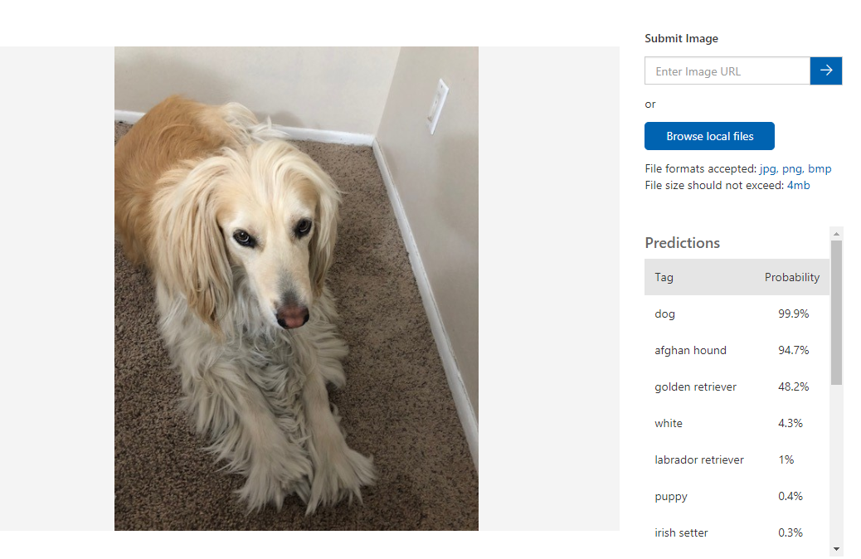
Who am I?
Bryan Starbuck
Senior Software Engineer
Specialize in IoT
Over 20 years development experience
Fun Stuff
Launched a weather balloon to 90,000 feet
Play guitar in rock bands
Love big dogs
Notes:
BlueMetal – a division of Insight
2018 Microsoft Worldwide Artificial Intelligence Partner of the Year Winner
2017 Microsoft Worldwide Mobile App Development Partner of the Year Winner
2016 Microsoft Worldwide Internet of Things Partner of the Year Winner

Slide 4
Agenda
Morning
 | 09:00 AM – 10:00 AM | - Introduction to Bot Framework & QnA Maker
 | 10:00 AM – 10:30 AM | - Bot Demo
 | 10:30 AM – 11:30 AM | - Lab 1 & 1.1 - Develop bots with Bot Builder and QnA Maker
 | 11:30 AM – 12:00 PM | - Lab 1.2 - Interacting with the User – Adding Rich Cards
 | 12:00 PM – 12:30 PM | - Lunch
Afternoon
 | 12:30 PM – 1:00 PM | - Interacting with the user – Dialogs, Cards, and FormFlow
 | 1:00 PM – 02:30 PM | - Lab 2 & 2.1 – Multiple Dialogs & Adaptive Cards
 | 02:30 PM – 03:00 PM | - Introduction to Cognitive Services & LUIS
 | 03:00 PM – 04:30 PM | - Lab 3 & 3.1 – Building Forms and Language Understanding
 | 04:30 PM – 05:00 PM | - Q&A
Notes:
Today we’re going to learn how to you can quickly build and test a simple bot.
This is an introductory to intermediate course where you are going to learn some of the key concepts and design principles on how to leverage the Bot Builder Tools, SDKs and Frameworks

Slide 5

Prerequisites and setup steps
Download links:
Visual Studio 2015 or later
https://www.visualstudio.com/downloads/
Requires .NET Framework (to install templates)
Templates
Application Template - http://aka.ms/bf-bc-vstemplate
Belongs in the ~\Visual Studio 2017\Templates\ProjectTemplates\Visual C#\Bot Application.zip
Bot Controller Template - http://aka.ms/bf-bc-vscontrollertemplate
Belongs in the ~\Visual Studio 2017\Templates\ItemTemplates\Visual C#\Bot Controller.zip
Bot Dialog Template - http://aka.ms/bf-bc-vsdialogtemplate
Belongs in the ~\Visual Studio 2017\Templates\ItemTemplates\Visual C#\Bot Dialog.zip
IIS Express
https://www.microsoft.com/en-us/download/details.aspx?id=48264
Bot Emulator
https://emulator.botframework.com/
Notes:
Microsoft Account
https://signup.live.com

Slide 6
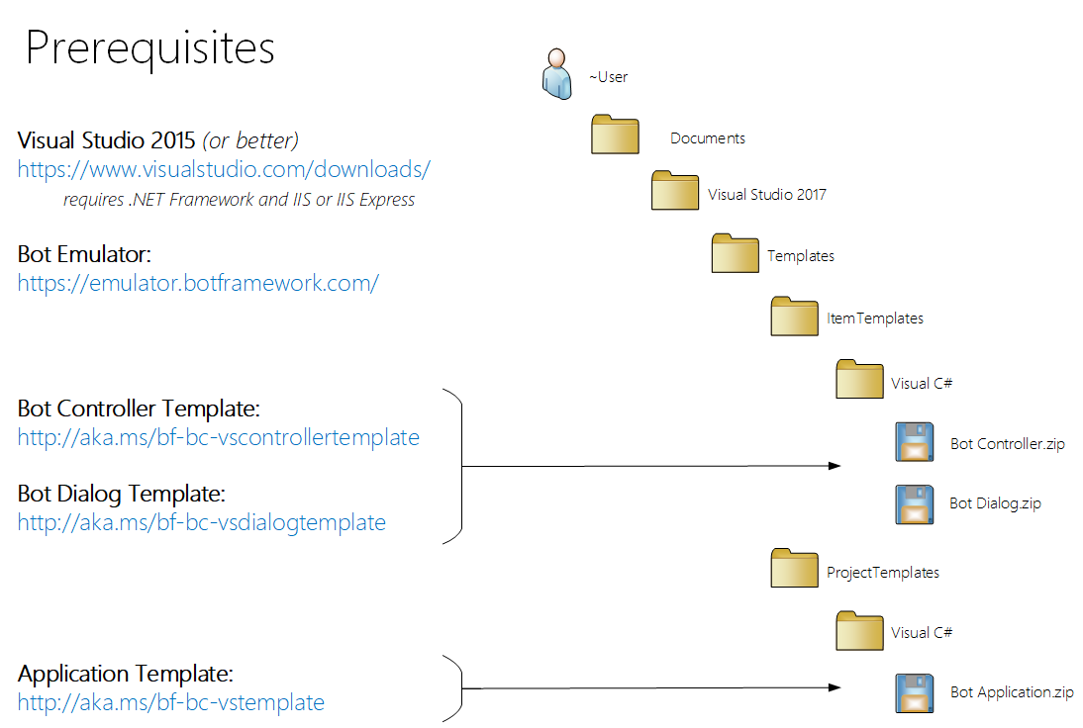

Slide 7




What is a bot?
Platform
Platform services
HTTP
AI
{ Your Code }
Intelligent tools
REST Endpoint
SDK
Bot builder SDK
REST endpoint
Direct Line Protocol
Conversational and business logic
Canvas aware
Context sensitive
Notes:
Think of a bot as an app that users interact with in a conversational way. This can be with text, cards, or even with speech. A bot may be as simple as basic pattern matching with a response, or it may be a sophisticated weaving of artificial intelligence techniques with complex conversational state tracking and integration to existing business services.
The Microsoft Bot Service enables us to build bots that support different types of interactions with users. We can design conversations in your bot to be freeform, or are bots can have a more guided interaction where it provides the user choices or actions.
The conversation can use simple text strings or more complex rich cards that contain text, images, and action buttons. And you can add natural language interactions, which let your users interact with your bots in a natural and expressive way.

Slide 8
Kinds of bots
Scenario | Retail | Finance | Insurance | Telecoms | Government | Automotive | Manufacturing | Healthcare | Media | Events
Customer service | ✔ | ✔ | ✔ | ✔ | ✔ | ✔ | ✔ | ✔ |  | ✔
Customer retail | ✔ | ✔ | ✔ | ✔ |  |  |  | ✔
Audio/speech analysis | ✔ | ✔ | ✔ | ✔ | ✔ |  |  |  | ✔
Translation |  | ✔ | ✔
Surveillance |  | ✔ |  |  | ✔
Knowledge extraction |  | ✔ | ✔ | ✔ |  |  | ✔
Video/photo analysis |  | ✔ |  |  | ✔ |  |  |  | ✔
Product identification | ✔ |  |  |  |  |  | ✔ | ✔
Digital assistant |  |  |  |  |  | ✔
Footfall analysis | ✔ |  |  |  |  |  |  |  |  | ✔
HD maps and object detection |  |  |  |  |  | ✔

Slide 9
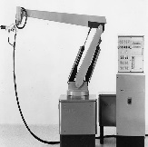

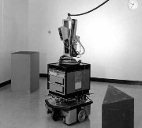

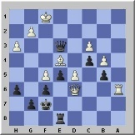
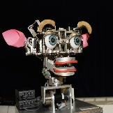

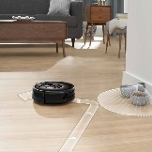
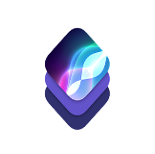


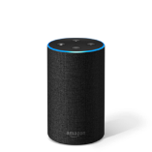
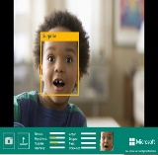


Bot’s are not new
1950 Turing Test
1955 AI Born
1961 Unimate
1964 Eliza
1966 Shakey
1977 Zork
1997 Deep Blue
1998 Kismet
1999 Aibo
Computer scientist Alan Turing proposes a test for machine intelligence.
Term “Artificial Intelligence” is coined by computer scientist John McCarthy
First industrial robot, Unimate, goes to work at GM replacing humans on the assembly line
Pioneering chatbot developed by Joseph Weizenbaum at MIT holds conversations with humans
The ‘first electronic person’ from Stanford, Shakey was a general-purpose mobile robot which reasoned about its own actions
One of the earliest interactive fiction games, included a sophisticated text parser that was not limited to simple verb-noun commands
Deep Blue, a chess-playing computer from IBM defeats world chess champion, Garry Kasparov
Cynthia Breazeal at MIT introduces KISmet, an emotionally intelligent robot that detects and responds to people’s feelings
Sony launches first consumer robot pet dog AiBO (AI robot) with skills and personality that develop over time
2002 Roomba
2011 Siri
2011 Watson
2014 Eugene
2014 Alexa
2015 Project Oxford
2016 Tay
2017 AlphaGo
First mass produced autonomous robotic vacuum cleaner from iRobot learns to navigate and clean homes
Apple integrates Siri, an intelligent virtual assistant with a voice interface, into the iPhone 4S
IBM’s question answering computer Watson wins first place on popular television quiz show Jeopardy
Eugene Goostman, a chatbot passes the Turing Test with a third of judges believing Eugene is human
Eugene Goostman, a chatbot passes the Turing Test with a third of judges believing Eugene is human
Microsoft releases Project Oxford, a collection of tools that allow developers to integrate AI capabilities into their apps.
Microsoft’s chatbot Tay goes rogue on social media making inflammatory and offensive racist comments
Google’s AlphaGo beats world champion Ke Jie in the complex game of Go, notable for its vast number (2*170) of possible positions
source: https://digitalintelligencetoday.com
Notes:
I’m not going to cover all of these events, but I do want to hit a few highlights…
Back in 1950, a mathematician named Alan Turing proposed a test to answer the question of whether machines are technically capable of showing intelligent behavior. He based the test on a party game where a man and a woman go into separate rooms, and then the other partygoers have to try and tell them apart by sending them questions and reading their typewritten responses. In the Turing Test, one of the rooms contains a computer — and if it can fool the partygoers into thinking it’s a human, then it passes the test.
In 1964 a researcher at MIT developed ELIZA, an early natural language processing program. Eliza simulated conversation by using a 'pattern matching' and substitution methodology that gave users an illusion of understanding on the part of the program, but had no built in framework for contextualizing events.
Jumping forward to 1977, we get to Zork. Now granted Zork isn’t really a bot in the context that we have defined, but it did introduce a number of features that still influence bot creators to this day. One of these key features was a word parser that took words the players typed and translated them into commands the game could process and respond to, propelling the story forward.
The parser allowed Zork to understand far more words than previous games, including adjectives, conjunctions, prepositions, and compound verbs. That meant Zork could support intricate puzzles, such as one that let players obtain a key by sliding paper under a door, pushing the key out of the lock so it would drop onto the paper, and retrieving the paper. The parser also let players input sentences like “Take all but rug” to scoop up multiple treasures, rather than making them type “Take [object]” over and over.
Elizabeth Woyke did a very interesting article called The Enduring Legacy of Zork for MIT Technology Review that is worth a read.
In 2014, 64 years after Alan Turing proposed a method of testing whether a machine has obtained human-level intelligence, a 13-year-old AI boy called Eugene Goostman finally became the first artificial intelligence to pass the Turing Test.
In 2015, Microsoft released Project Oxford which has since become Cognitive Services. These are a collection of AI enabled SDKs that cover a broad ecosystem that includes natural language processing, facial and voice recognition, sentiment analysis, content moderation… the list goes on. We’ll use some of these tools later today in one of our labs.
The following year, Microsoft introduced Tay. Tay was originally launched to test and improve Microsoft's understanding of conversational language. Unfortunately, right after Tay launched people started sending her racist and inflammatory tweets, and Tay – being basically a parrot with an internet connection - started spewing these things back proving the old programing rule of Garbage In – Garbage Out.
Now to be fair to Tay, most of the worst things she said were because she had a “Repeat After Me” feature that users were exploiting.
Tay is gone but I think she can teach us a lot of valuable lessons. Most importantly is that a bot is like any other program, and if as developers we don’t anticipate or plan for exceptions in our code, we can inadvertently introduce vulnerabilities that people can, and will take advantage of.

Slide 10



Why a bot?
TYPE
TALK
TAP
Bot builder
Cortana
Facebook Messenger
Skype
Platform services
Intelligent tools
Bing
Notes:
Messaging is the way most people communicate today. So, it’s quite obvious that the average customer would want businesses communicating with them using the same channels. Unfortunately, most businesses out there don’t seem to get this. Many of them still insist on using email or phone calls.
A chatbot is a service designed to simulate human conversations, generally over the Internet, using Artificial Intelligence (AI) and Machine Learning. In other words, a chatbot is a service that can have a conversation with you just like a real person.
It’s likely that you’ve already heard about chatbots in the context of customer service, but chatbots can do a lot more than that. Bots can be functional or fun, and they can actually play a key role in the overall sales process and deliver definite value to your business.

Slide 11




Bots offer clear business value
Bots provide clear ROI with time and cost savings and better user experiences
Engage with customers where they already are
Connect people to a wealth of information
Enable easier development than mobile apps
Automate repetitive tasks to save time
Tell me where the nearest pub is
Tim
Schedule a payment
Pubs nearby
Insurance bot
Quis tortor
Distance
Use card on file?
.5 kilometer
Tim
Yes
Skype
Facebook
Feugiat placerat
3 kilometer
Insurance bot
Interdum velit
4.2 kilometer
Schedule payment date?
Pubs nearby
Tim
11/23/2016
Slack
Insurance bot
Payment scheduled
Notes:
A bot can take food orders or make a reservation.
Assume that you are building a bot for a hotel chain. You can design a bot that can collect the guest information, when and where they want to stay, the type of room they would like to stay in, and any special accessibility needs that they may have. That same bot can confirm the reservation, send the email confirmation, and with a little tweaking you can have that bot reach out to that guest on Slack or Skype a day before they are due to arrive to remind them of their reservation.
It can influence and drive sales.
Sales can be a complicated function and sometimes, businesses are simply overwhelmed with the number of customers they have to deal with. Chatbots can serve as a unique solution to this problem.
H&M has a bot that can ask customers questions regarding their particular taste or style, and based on the information provided it can deliver options the customer. Not only does this bot offer relevant suggestions, it’s a 24×7 sales assistant.
They enable real-time engagement with your customers
Chatbots can answer queries in real-time and the best part is, they can handle a large number of queries from multiple customers at the same time. They can even be programmed and trained to understand FAQs or other key questions in order to provide the exact solutions.
Chatbots are a powerful and efficient communication tool which ultimately empower your customers to solve their problems quickly and ideally all on their own. Chatbots are also a great back up for employees to handle repetitive tasks and are cost-effective, easy to implement, maintain and use.
In the long run, this can make your company appear more efficient, feel as if it is one step ahead of the competition, and at the same time improve your brand perception.

Slide 12



What is the bot framework?
What?
Tools for building REST websites
Services to enrich
Mechanisms for receive events
Data to debug and tools to analyze
Why?
Implements standard protocols
Modeling conversations is hard; tools help!
UI across multiple canvases is hard; cards rock!
Language understanding is hard
Common and well understood patterns
Goals
Start simple; add complexity; no dead-ends
Bot adapts to the user, based on context
Composable and intelligent controls to manage complexity
Customer’s
business logic and data
Bot connector
C#
BOT BUILDER
Bot Controls
Skype
Bing
WebChat
LUIS
Form Filling
QnA
Skype for Business
Cortana
Direct Line
Query over database via Azure Search
Third-party
Notes:
The Microsoft Bot Framework provides all of the tools we need to build and connect intelligent bots that interact naturally with our users and customers.
It also provides us tools to automatically translate those conversations into more than 30 languages, manage user and conversation state, and add AI to create rich and immersive conversations that our audience will enjoy using.
And it’s all built using common standards and protocols, so we can use whatever language we want. It doesn’t matter if your team is using C#, JAVA, NodeJS, or even Classic ASP. If your language of choice can handle RESTful services, you can implement a bot.

Slide 13















UX SUPPORT Channels
WebChat
DirectLine

Slide 14



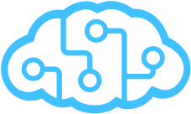

Bot Framework
Bot Builder
Azure Bot Service
Cognitive Services
Tools and services
Connect your bots
AI services to add intelligence
Open source
From prompts & dialogs to form flows
Rich attachments
Online/offline chat emulator
Add bot smarts for language understanding
Register, connect, publish and manage your bot
Automatic card normalization
Embeddable Web chat
Direct Line API
Bot Directory
Parse natural language
Real-time transcription and translation services for voice
Vision and face detection algorithms
Sentence diagramming
Web language parsing
Notes:
Bot Builder
Bot Builder provides an SDK, libraries, samples, and tools to help us build and debug bots. You can also use the Bot Builder SDK to create a bot from scratch using C# or Node.js. If you want to build a bot using any programming language you want, you can use the REST API.
Bot Builder includes the Bot Framework Emulator for testing your bots and the Channel Inspector for previewing your bot's user experience on different channels.
Azure Bot Service
All day long we use multiple tools to communicate with each other; email, Skype, Slack, Facebook. If this is where we are talking, our bot should be as well.
The Azure Bot Service let’s us register and publish our bots, as well as connect and integrate them across multiple channels, so we can reach and interact with our users on the social platforms that they’re already using, and that they are already familiar with.
Cognitive Services
Intelligent bots respond as if they can see the world as people see it. They discover information and extract knowledge from different sources to provide useful answers, and, best of all, they learn as they acquire more experience to continuously improve their capabilities.
Microsoft Cognitive Services lets you tap into a growing collection of powerful AI algorithms developed by experts in the fields of computer vision, speech, natural language processing, knowledge extraction, and web search. The services simplify a variety of AI-based tasks, giving us a quick way to add state-of-the-art intelligence technologies to our bots with just a few lines of code.
The APIs are also constantly evolving, learning, and getting smarter, so experiences are always up to date.

Slide 15
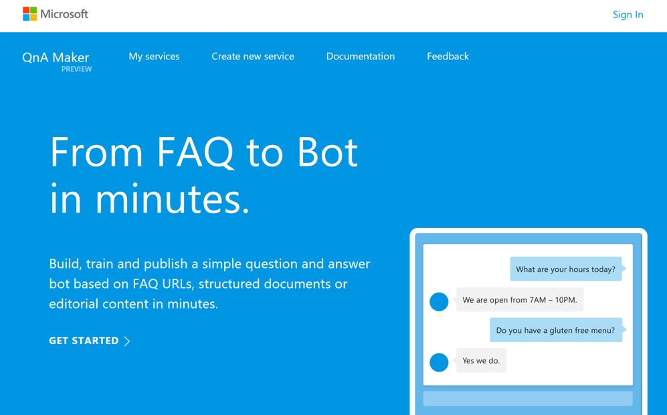
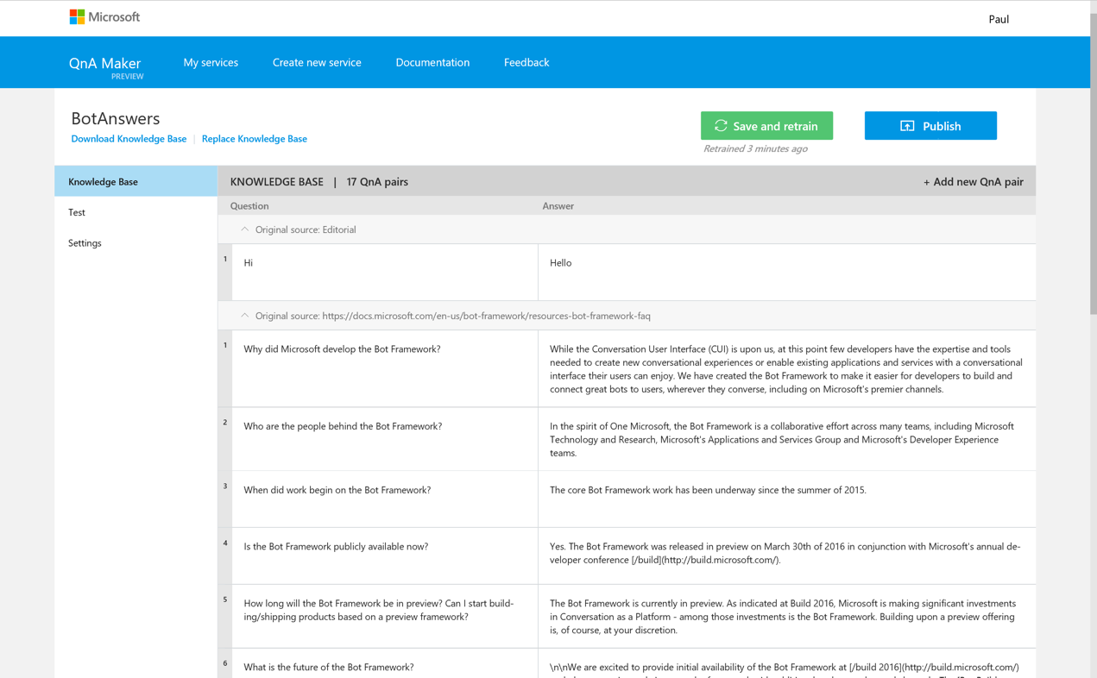
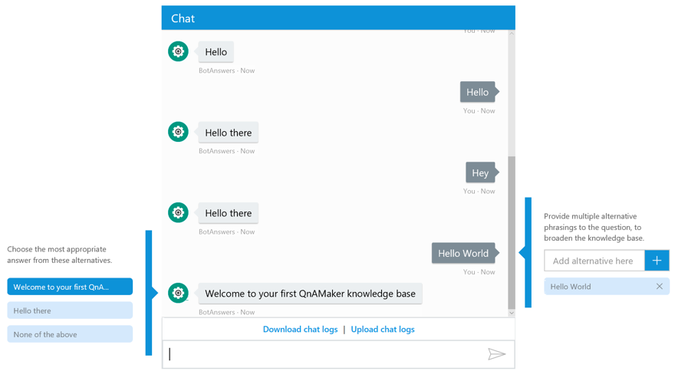
BUSINESS USER ACCESSIBILITY QnA Maker
Distill information into conversational, easy-to-navigate answers

Slide 16
Litware Insurance Bot Demo
Notes:
https://cisbot-prod.azurewebsites.net/
Litware Insurance Bot Demo
User: Bot
Password: Azure

Slide 17

Anatomy of a typical bot
Conversation Canvas/Channels
Your bot code goes here
Web Chat
Bot Connector Service
Email
Message input <> output
State Management
Facebook
Bot web service
Bot Builder SDK
GroupMe
Your bot code
Kik
Skype
Bot Builder SDK
API, SDK calls
Slack
+ Microsoft Cognitive Services
Telegram
Other services, APIs,
Databases, Azure Machine Learning, Azure Search, etc…
Natural Language
Translation
Vision/Face
Emotion
Twilio (SMS)
…
Direct Line
Speech
Entity Extraction
Search
Knowledge API
…
…
…
Notes:
All of this looks and sounds great… but what we’ve really come here to do is learn how to build bots and we’re just about ready to do that. But before we jump into our first lab, we’re going to take a quick look at what elements make up a bot when we’re using the Microsoft Bot Framework.
[CLICK]Starting at the beginning with our bot web service. This is where we put our code that interacts with the Bot Builder SDK.
The Bot Builder SDK is available for both .NET and NodeJS. It gives us a powerful, ready-to-use framework that we can build on for constructing bots that can handle both free-form interactions and more guided conversations where the user selects from possible values.
[CLICK]The SDK integrates with the Bot Connector Service and the Bot State Service.
[CLICK]The Bot Connector service enables your bot to exchange messages with channels configured in the Bot Framework Portal as well as the Bot State service that enables our bots to store and retrieve state data that is associated with a user, a conversation, or a specific user within the context of a specific conversation.
[CLICK]Our bot can also integrate with any of the Microsoft Cognitive Services through standard REST calls,
[CLICK]or to an external service, a third party API, it can retrieve information from our database, or execute any business logic that it needs to complete a request.

Slide 18
Lab 1, 1.1 & 1.2 – Develop bots with Bot Builder & QnA Maker with rich cards in .NET

Slide 19
Lunch

Slide 20
Lunch Topics
LearnAnalytics@MS
Microsoft AI School
Bot Service Documentation
Microsoft Virtual Academy
Partner Demos

Slide 21
Interacting with the User
Notes:
Most successful apps or websites have at least one thing in common: a great user experience. Bots are no different in that regard. So when we build a bot this needs to be one of our top priorities.
What makes a great bot user experience?
A great bot won’t require the user to type too much, talk too much, repeat themselves several times, or explain things to the bot that they think it should automatically know.

Slide 22
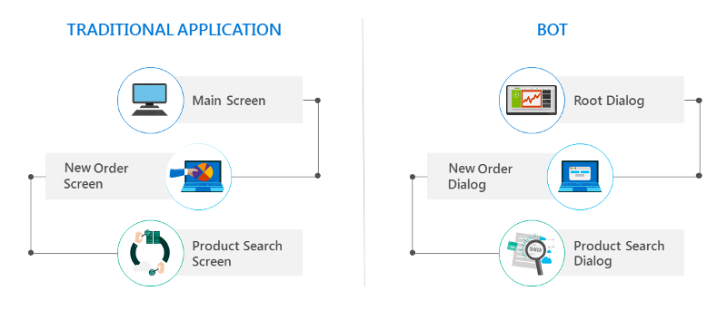
Dialogs are for bots like screens are for apps
Notes:
In a traditional application, the user interface (UI) is a series of screens. A single app or website can use one or more screens as needed to exchange information with the user. Most applications start with a main screen where users initially land and provide navigation that leads to other screens for various functions like starting a new order, browsing products, or looking for help.
Bots have a UI as well, but it is made up of dialogs rather than screens.
Dialogs enable us to logically separate various areas of bot functionality and guide conversational flow. For example, we can design one dialog to contain the logic that helps the user browse for products and a separate dialog to contain the logic that helps the user create a new order.
We can create dialogs that have graphical interfaces, that contain buttons, text, and other elements, or even ones that are entirely speech-based.
Dialogs can also contain actions to perform tasks such as invoking other dialogs or processing user input.

Slide 23
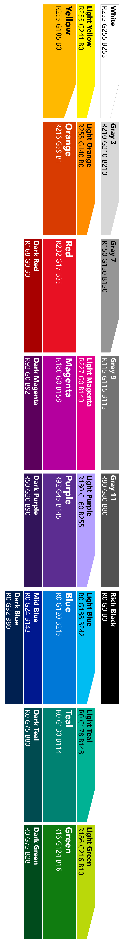
Modelling your conversation
Roll your own state management etc.
Multi layered
conversations
Bespoke
Dialogs
Data capture,
“Web forms” scenarios
Flexibility
FormFlow
FAQs,
command & control
QnA
Effort to implement

Slide 24
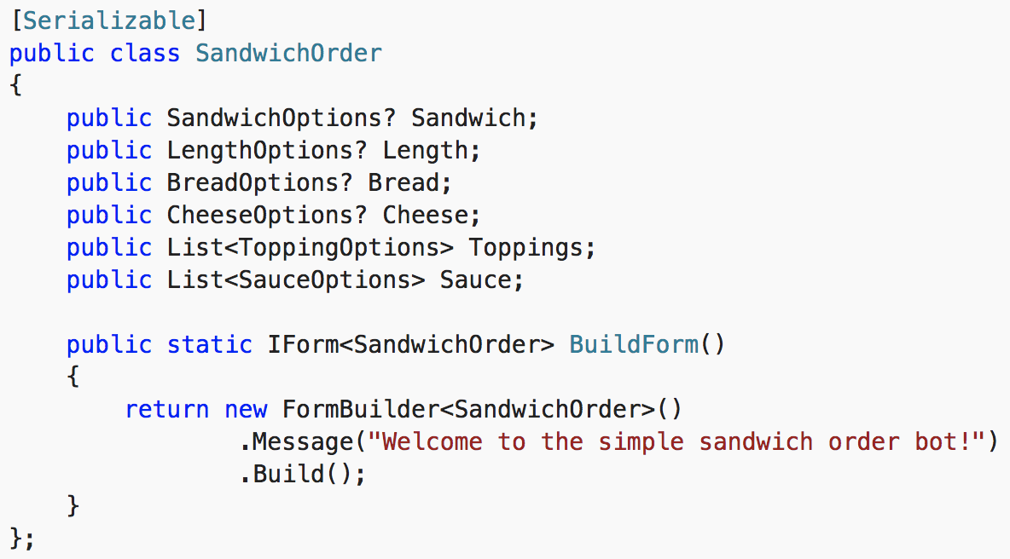
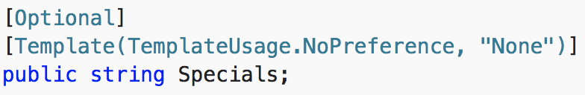
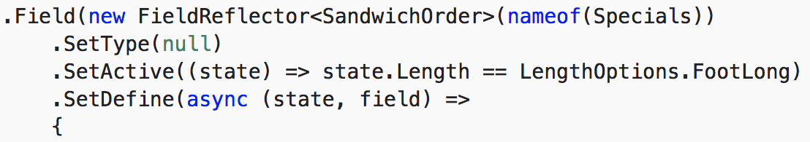
Forms are data binding for bots
Best approach for guided interactions
Define a serializable model
SDK handles collecting, binding, and flow operations (like quit)
Extended via declarative attributes or via code
Notes:
Most successful apps or websites have at least one thing in common: a great user experience. Bots are no different in that regard. Therefore, ensuring a great user experience should be your number one priority when designing a bot. Some key considerations include:
Does the bot easily solve the user’s problem with the minimum number of steps?
Does the bot solve the user’s problem better/easier/faster than any of the alternative experiences?
Does the bot run on the devices and platforms the user cares about?
Is the bot discoverable? Do the users naturally know what to do when using it?
Note that none of these questions directly relates to factors such as how smart the bot is, how much natural language capability it has, whether it uses machine learning, or which programming language was used to create it. Users are unlikely to care about any of these things if the bot solves the problem that they need to address and delivers a great user experience. A great bot user experience does not require users to type too much, talk too much, repeat themselves several times, or explain things that the bot should automatically know.

Slide 25
Multi layered conversation
Notes:
Most successful apps or websites have at least one thing in common: a great user experience. Bots are no different in that regard. Therefore, ensuring a great user experience should be your number one priority when designing a bot. Some key considerations include:
Does the bot easily solve the user’s problem with the minimum number of steps?
Does the bot solve the user’s problem better/easier/faster than any of the alternative experiences?
Does the bot run on the devices and platforms the user cares about?
Is the bot discoverable? Do the users naturally know what to do when using it?
Note that none of these questions directly relates to factors such as how smart the bot is, how much natural language capability it has, whether it uses machine learning, or which programming language was used to create it. Users are unlikely to care about any of these things if the bot solves the problem that they need to address and delivers a great user experience. A great bot user experience does not require users to type too much, talk too much, repeat themselves several times, or explain things that the bot should automatically know.

Slide 26


Slide 28


Slide 29


Slide 30
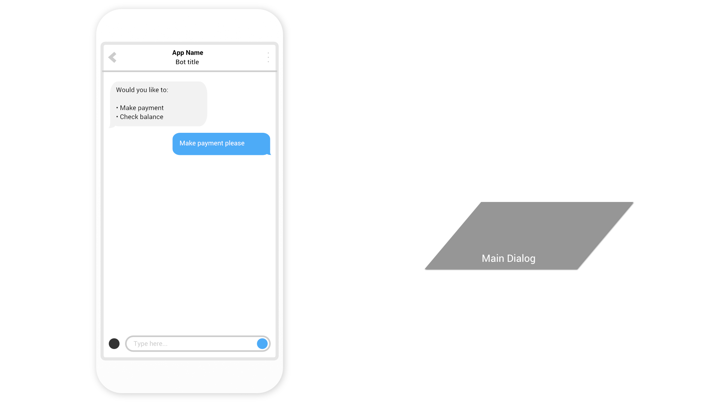

Slide 31
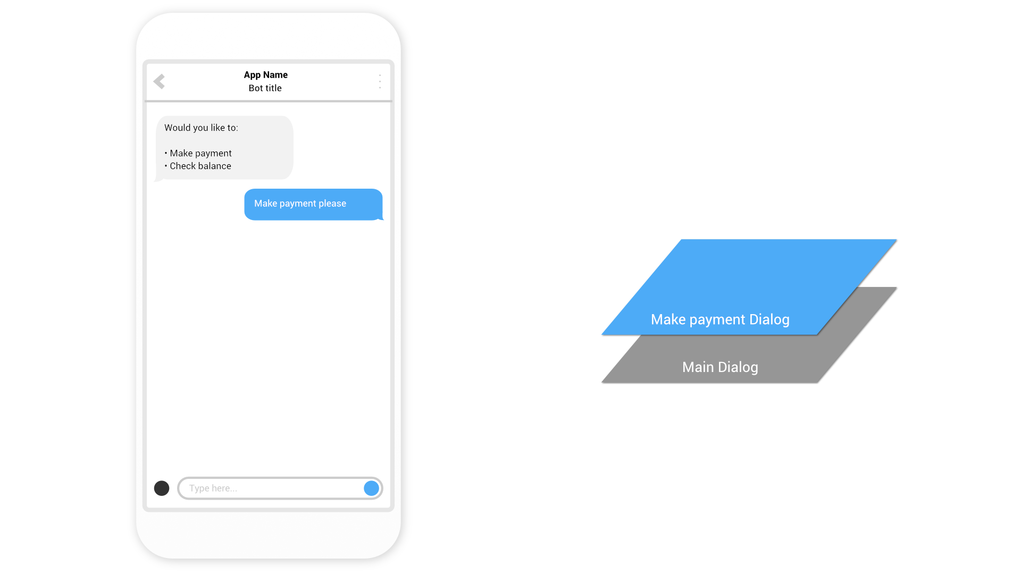

Slide 32


Slide 33
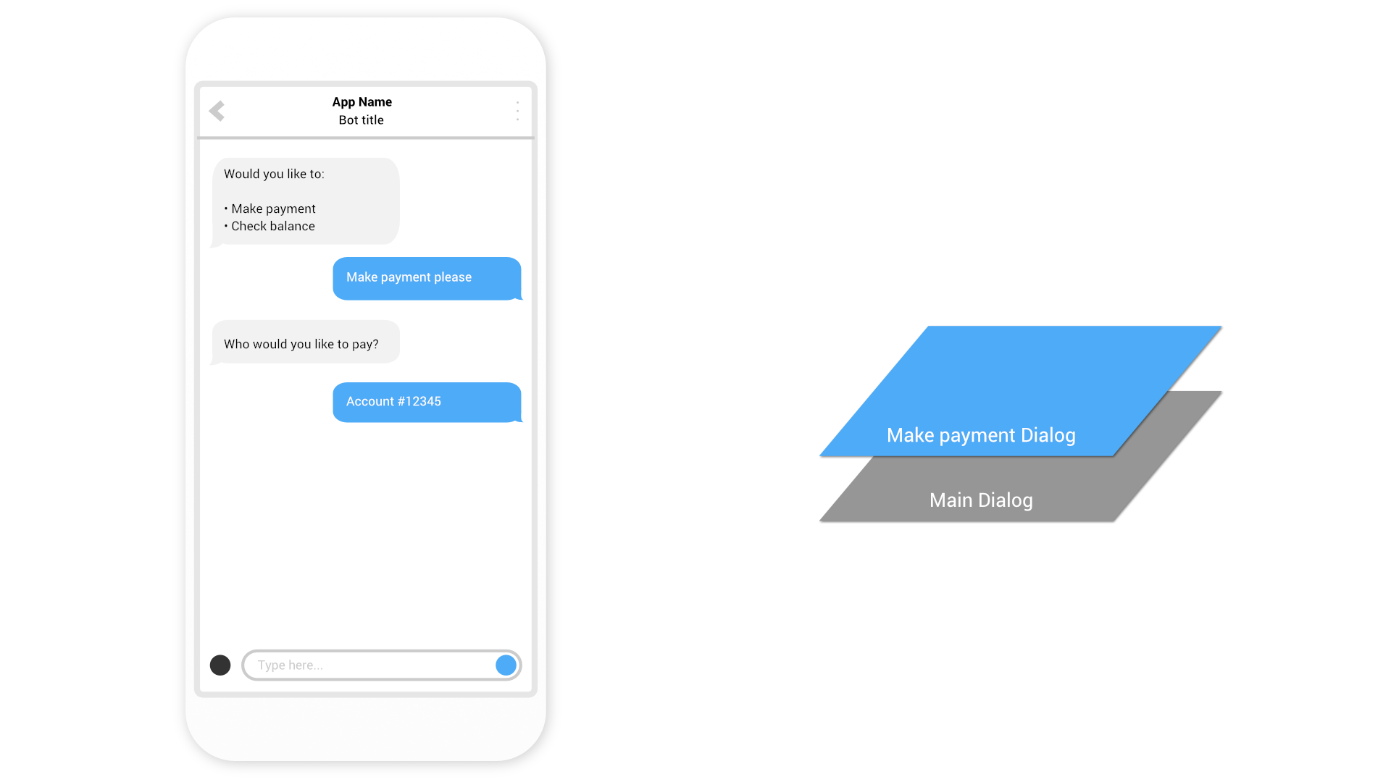

Slide 34


Slide 35
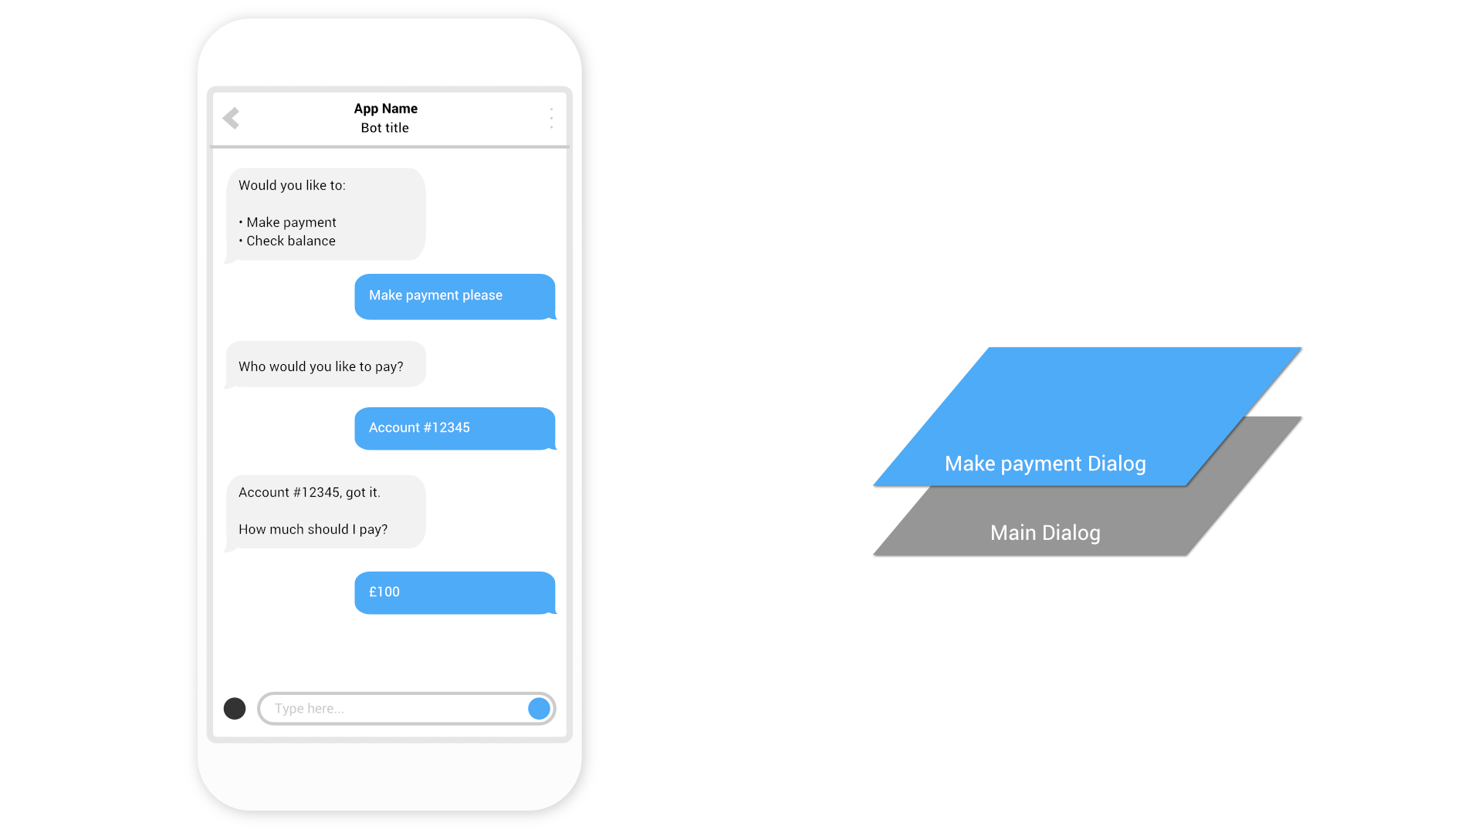

Slide 36
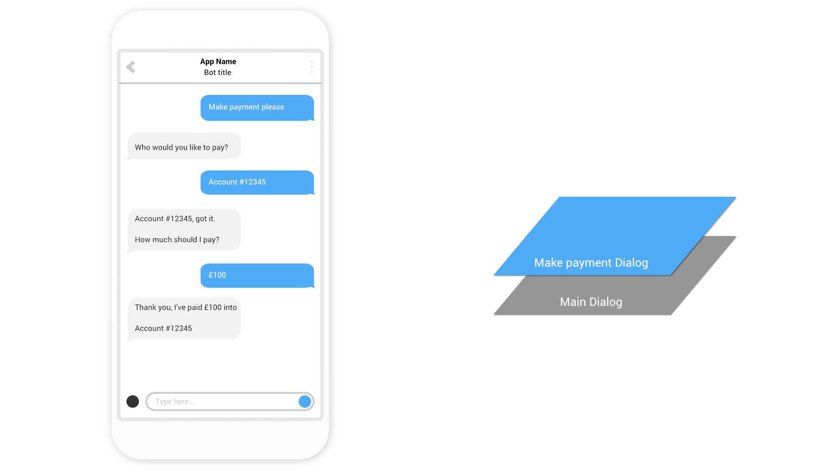

Slide 37


Slide 38


Slide 39


Slide 40
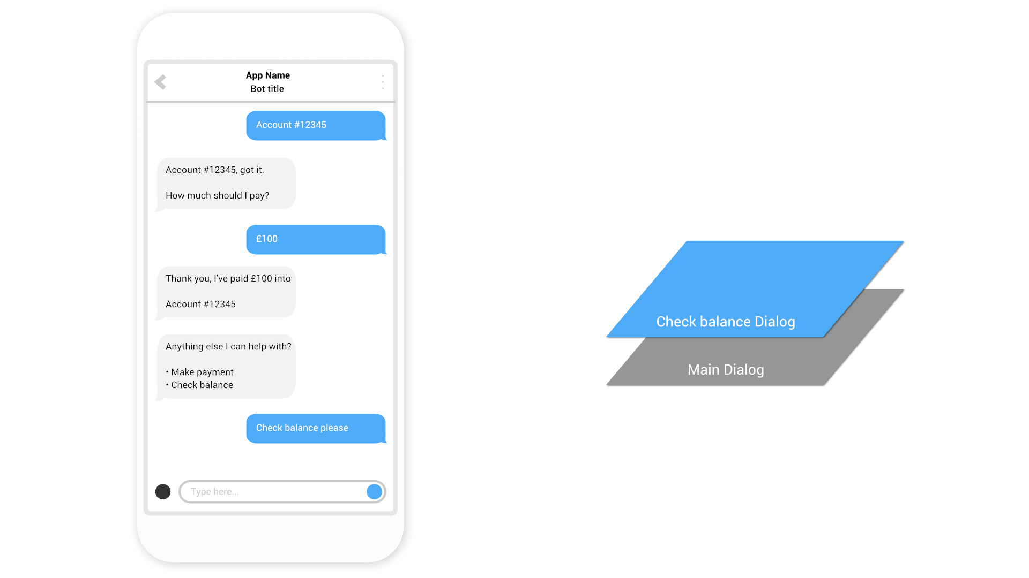
This is how we know how to navigate “back” but users won’t necessarily think that way
So be careful with too much “modality”: things can get complex quickly…

Slide 41
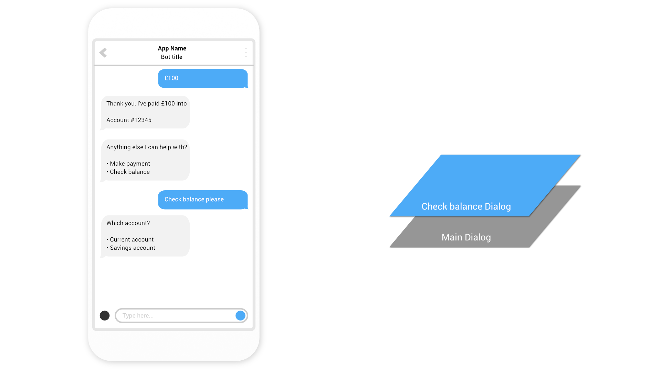

Slide 42
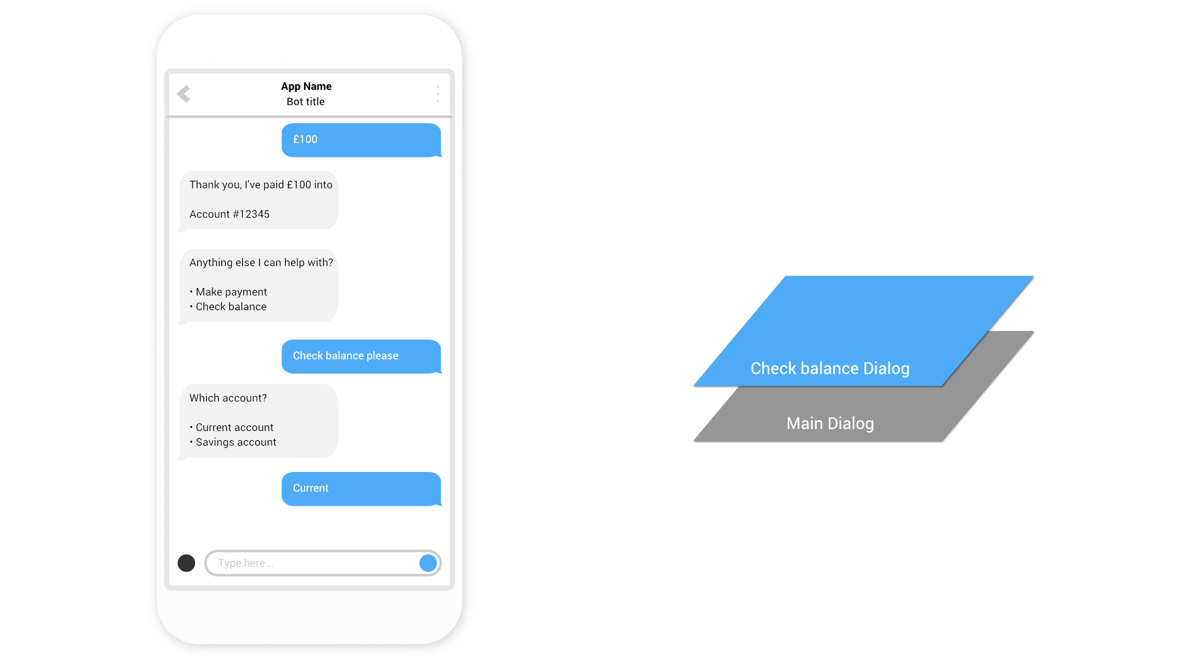

Slide 43
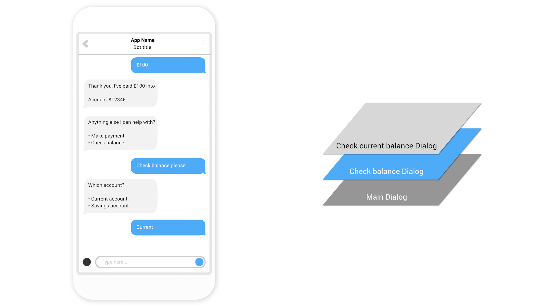

Slide 44
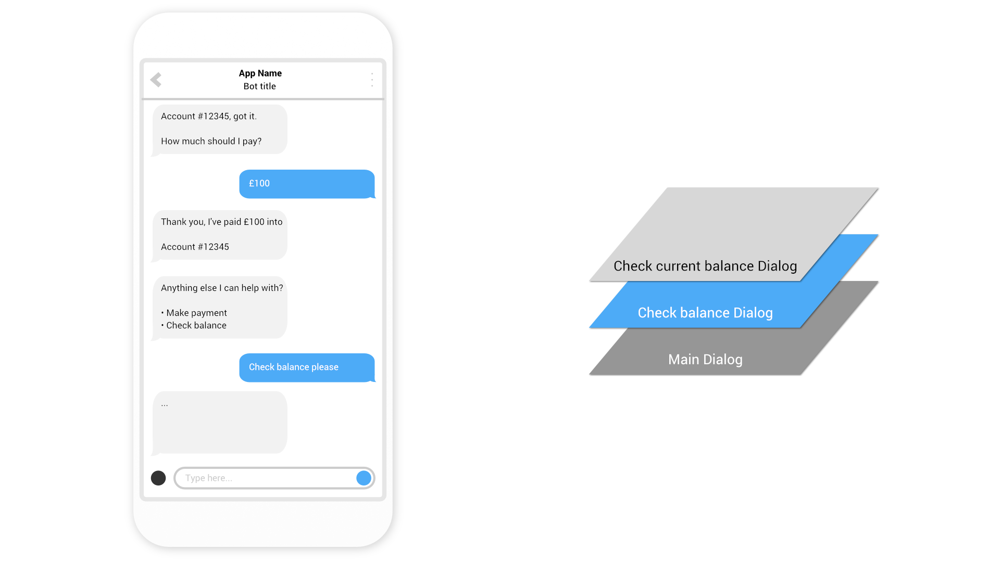

Slide 45
Interacting with the User
Prompts are how you ask user questions
Free form – text
Data type detection – number, datetime
List of options – confirm, choice
Media - attachments
Introducing Cards
Graphics are pretty
We want to move beyond just basic text
Display images
Formatted text
Add click-ability

Slide 46
Lab 2 – Interacting with the User
Notes:
With the Bot Framework you can write a single bot that is able to chat with users across multiple channels like Skype, Facebook Messenger, Slack, etc.

Slide 47
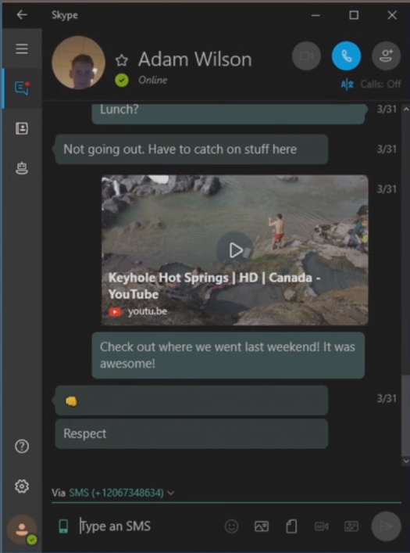
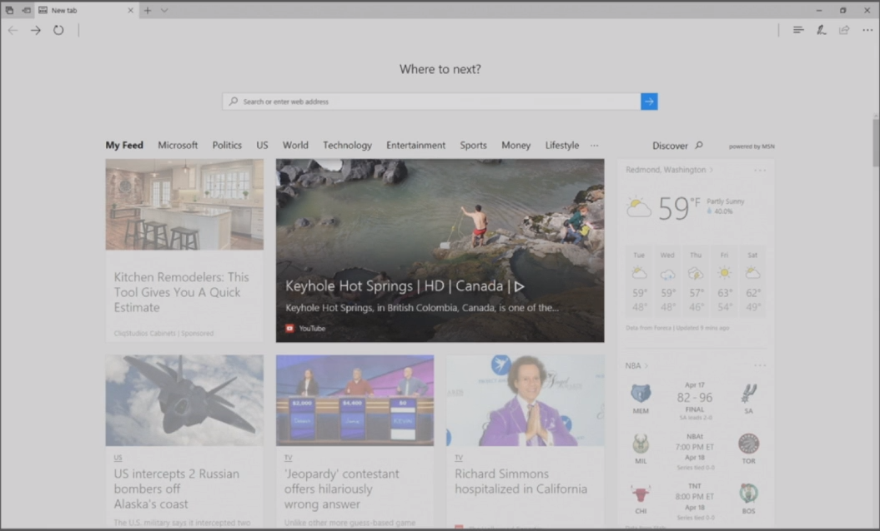
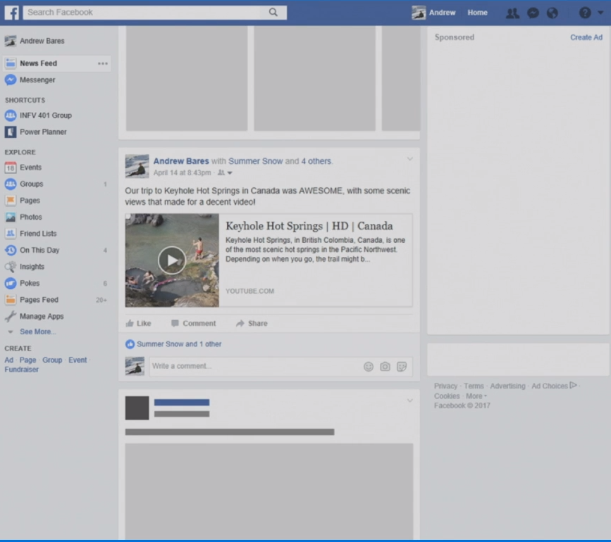
Adaptive Cards
Notes:
As a consumer we see cards all over the place, Facebook is a very common example. As I'm scrolling through a Facebook feed here you'll notice we have a news article with a link to a YouTube video on this members timeline.
If we switch over to the New Tab page of Microsoft Edge we see this card again. It's that same content as before, but in this case it it looks and feels like Edge.
I could also share this video to someone on Skype and it would create a little card like experience that now looks and feels native in Skype. It’s still the same content being passed around and the Host application is rendering it in a manner that makes it feel native to Skype.

Slide 48

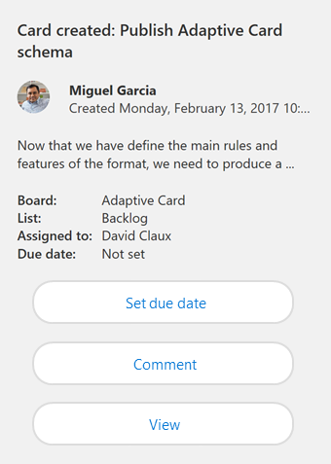
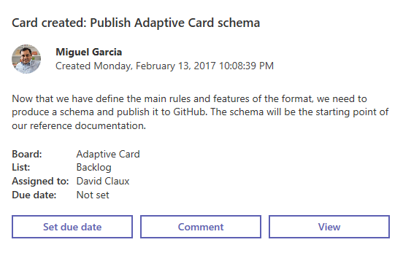
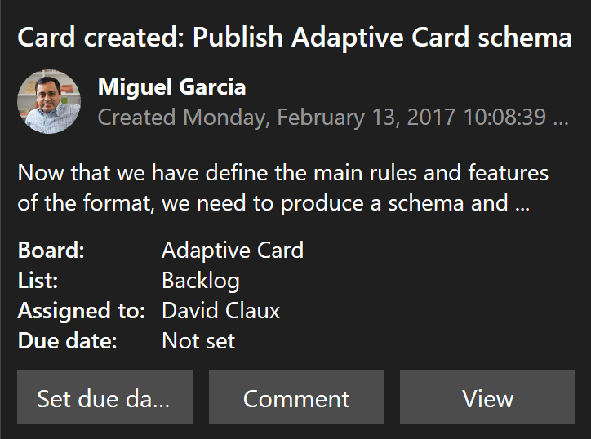
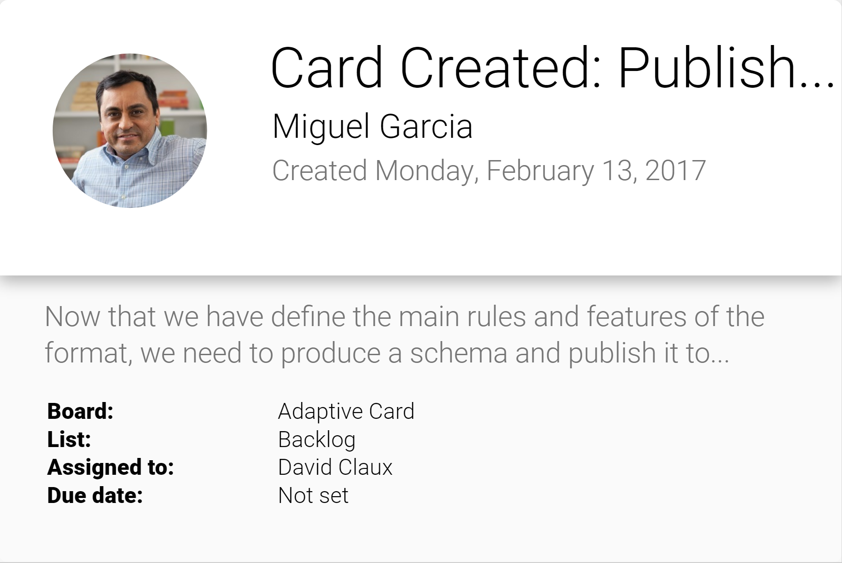
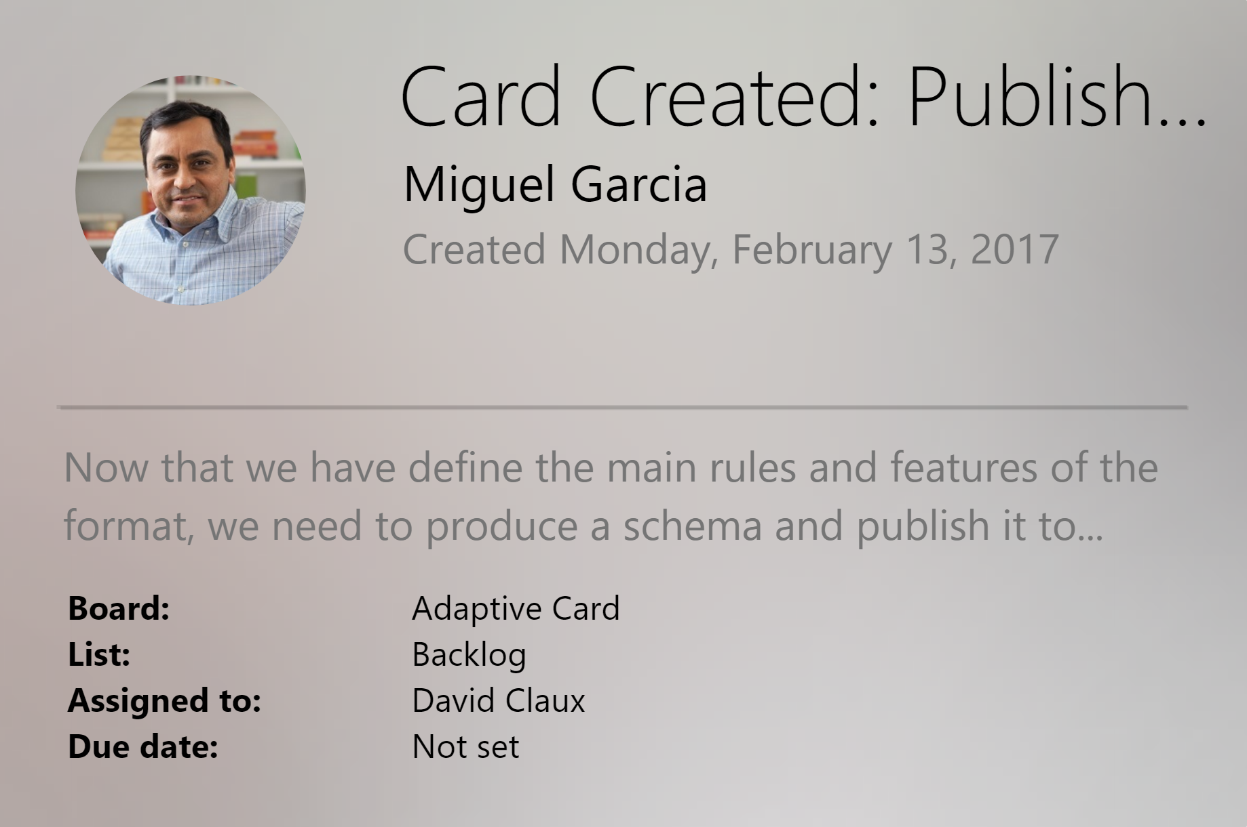
Adaptive cards
Open framework
Multiple canvases
Notification
Microsoft Teams
Skype
Android
iOS
https://docs.microsoft.com/en-us/adaptive-cards/
Notes:
Card Authors describe their content as a simple JSON object. That JSON is a representation of the content to be displayed, and it is then renrendered natively inside a Host Application, automatically adapting to the look and feel of the Host.
For example, our Bot can author an Adaptive Card through the Bot Framework, and when its delivered as a Windows Notification… it looks and feels like a Windows Notification. When that same card is delivered to Skype, it will look and feel like a Skype card. When that same payload is sent to Microsoft Teams, it will look and feel like Microsoft Teams. As more host apps start to support Adaptive Cards, that same payload will automatically light up inside these applications, yet still feel entirely native to the app.
Users win because everything feels familiar. Host apps win because they control the user experience.

Slide 49
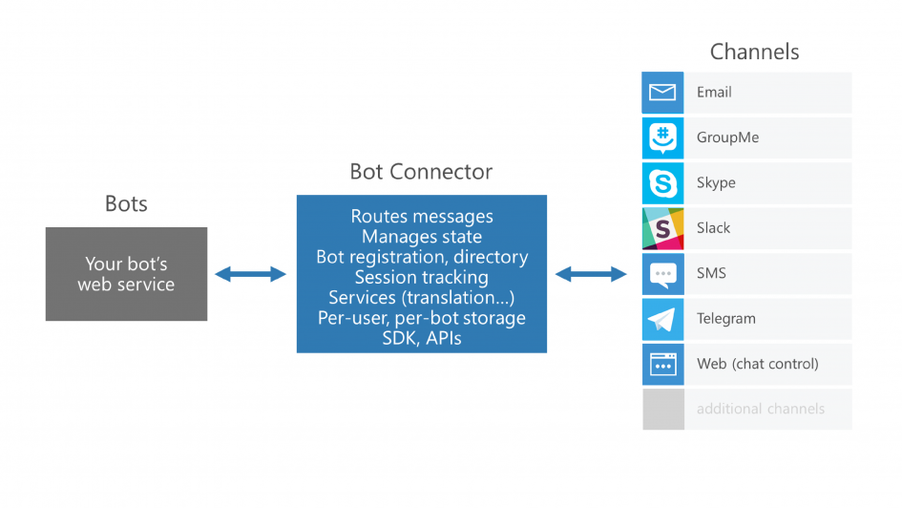
Adaptive Cards
Notes:
And as Card Authors we win because our content gets broader reach without any additional work.
The Bot Connector lets you connect our bots seamlessly to text/sms, Office 365 mail, Skype, Slack, and other services.
We just register our bot, configure desired channels and publish it in the Bot Directory.
Warning: Adaptive Cards is currently under development. While it is in preview, Microsoft is seeking feedback and says to expect a few rough edges.

Slide 50
Adaptive Cards Demo
Notes:
http://contososcubabot.azurewebsites.net

Slide 51
Lab 2 – Interacting with the User

Slide 52
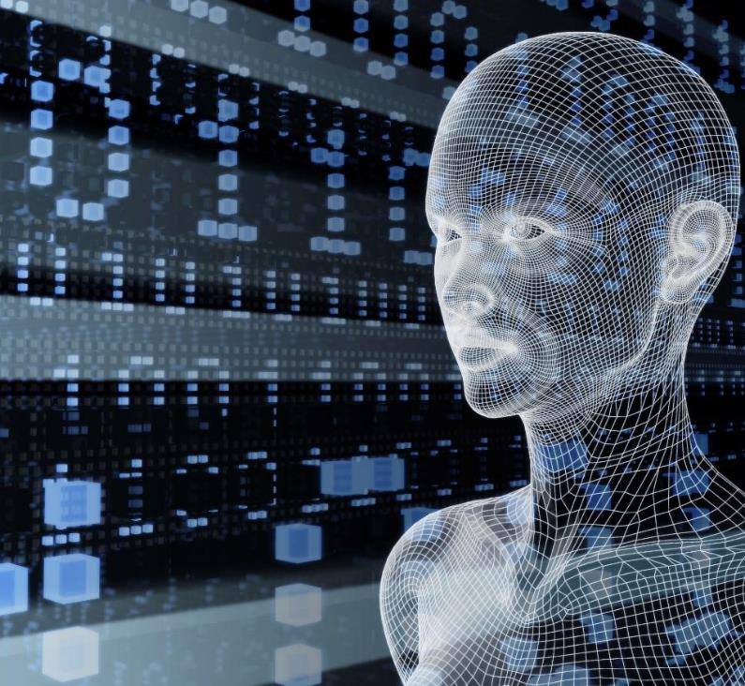

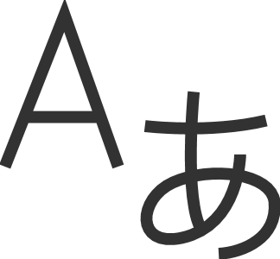
Microsoft Cognitive Services Give your apps a human side
Vision
From faces to feelings, understand images and video
Speech
Hear and speak, filtering noise, identifying speakers
Language
Process text, understand intent
Knowledge
Tap into rich knowledge amassed from the web, academia, or your own data
Search
Access billions of web pages, images, videos, and news with the power of Bing APIs
Labs
An early look at emerging Cognitive Services technologies

Slide 53
Microsoft Cognitive Services Give your apps a human side
Computer Vision
Content Moderator
Emotion
Face
Video Indexer
Custom Vision Service
Bing Speech
Speaker Recognition
Custom Speech Service
Bing Spell Check
Linguistic Analysis
Text Analytics
Translator Text & Speech
Web Language Model
Language Understanding
Academic Knowledge
Entity Linking
Knowledge Exploration
Recommendations
QnA Maker
Custom Decision Service
Bing Autosuggest
Bing Image Search
Bing News Search
Bing Video Search
Bing Web Search
Bing Custom Search
Project Prague (gesture)
Project Cuzco (events)
Project Wollongong (location)
Vision
Speech
Language
Knowledge
Search
Labs

Slide 54
Snake Bite Bot Demo
Notes:
Bot: https://snakebite.azurewebsites.net
Blog: https://aka.ms/snakebotblog

Slide 55
Natural language
Language understanding in human-computer interaction is:
Technically challenging
Costly
to implement
Often
domain specific
It’s exceedingly difficult to enable a computer to understand what a person wants and to find the pieces of information that are relevant to their intent.
Building and maintaining machine learning systems requires a large investment of time, money and engineering resources
In the past, building your own machine learned models often required assistance of a team of data scientists that would customize the models to the specific domain.

Slide 56
Language Understanding Intelligent Service
Train by providing examples
Create your own LU model
Deploy to an HTTP endpoint
Maintain model with ease
Notes:
LUIS enables you to integrate natural language understanding into your chatbot or other application without having to create the complex part of machine learning models. Instead, you get to focus on your own application's logic and let LUIS do the heavy lifting.
A typical LUIS app goes through the following 3 steps:
Design & Build
Train & Test
Publish & Improve

Slide 57
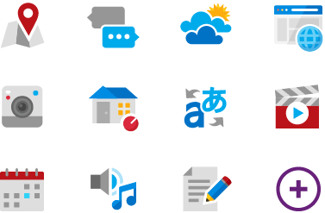


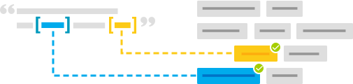
BREADTH Language Understanding (LUIS)
Machine learning-based service to build natural language into apps, bots, and IoT devices. Quickly create enterprise-ready, custom models that continuously improve
Add natural language to your apps
Quickly build a custom language solution
Always learning and improving
Enterprise-ready, available worldwide
Designed to identify valuable information in conversations, LUIS interprets user goals (intents) and distills valuable information from sentences (entities), for a high quality, nuanced language model.
Custom Models can be created based on the same technology in Azure Machine Learning.
Leverages customizable pre-built apps and entity dictionaries, (e.g., Calendar, Music, Devices).
Dictionaries are mined from the collective knowledge of the web and supply billions of entries, helping your model to correctly identify valuable information from user conversations.
LUIS integrates seamlessly with the Azure Bot Service, making it easy to create a sophisticated bot.
Active learning is used to continuously improve the quality of the natural language models.
Once the model starts processing input, LUIS begins active learning, allowing you to constantly update and improve the model.
The service is ready to be deployed in commercial applications and can scale with enterprise quality and performance.
The service meets international compliance standards, supports 13 languages and available worldwide, making it highly accessible around the world

Slide 58
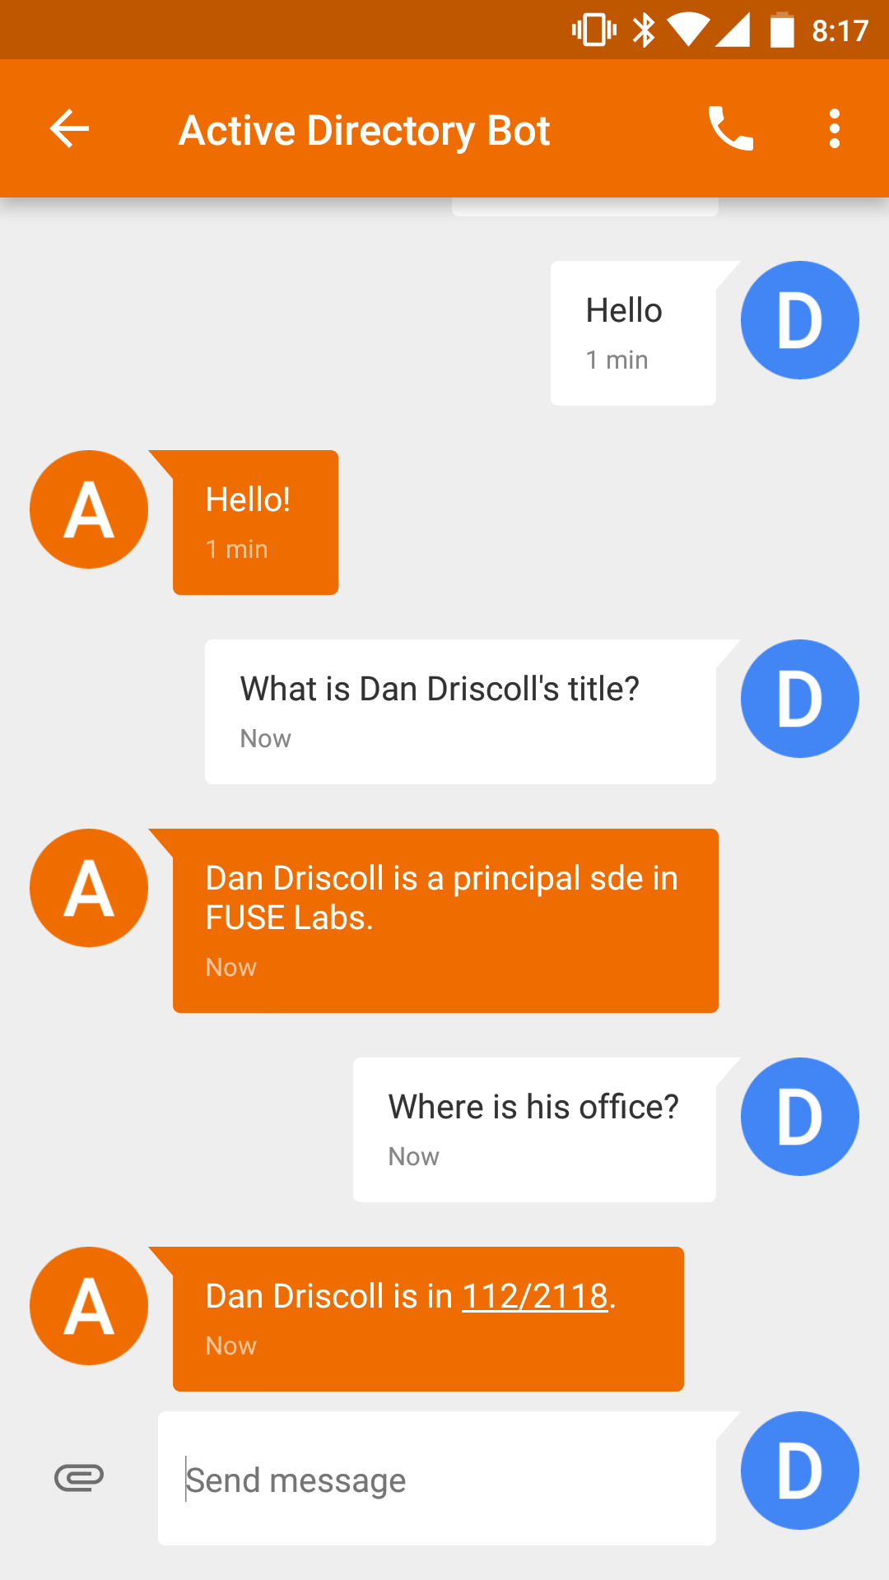
LUIS: Intents & Entities
Who is _____?
Where does ____ work?
What is _____’s phone number?
John
Sue
Erika
Examples of intent detection
Examples of entity extraction
Notes:
Intents
Intents are how LUIS determines understands what a user wants to do. If your client application is for a travel agency, then you will need the intents "BuyPlaneTicket" and "RentHotelRoom" in order to identify when your users want to perform these different tasks.
Utterances
An utterance is the textual input that LUIS will interpret. LUIS first uses example utterances that you add to an intent to teach itself how to evaluate the variety of utterances that users will input.
Entities
An entity is used like a variable in algebra, it will capture and pass important information to your client app. In the utterance, "I want to buy a ticket to Seattle", you would want to capture the city name, Seattle, with the entity, like destination_city. Now LUIS will see the utterance as, "I want to buy a ticket to {destination_city}". This information can now be passed on to your client application and used to complete a task.

Slide 59
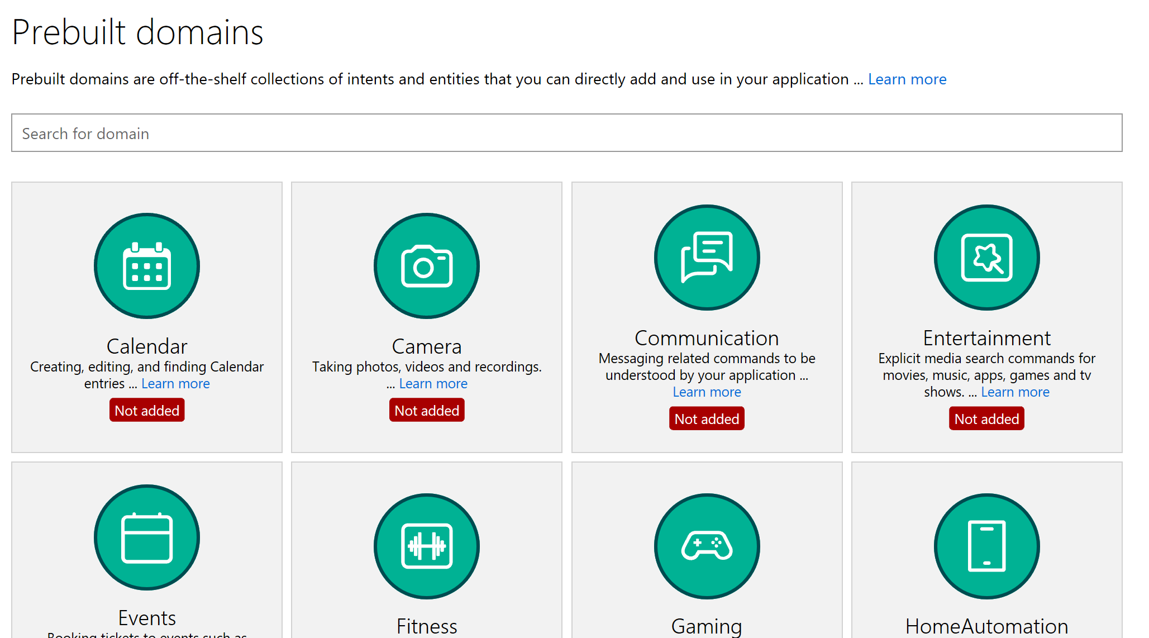
LUIS: Quick Start
Kick start your language model construction through modifiable 20 pre-built domains
Adds Intents, Entities, Utterances
Improved number, unit, money and date/times (e.g. “From May 1st to May 5th”)
Supports English, French, Dutch, Spanish, Italian, German, Korean, Portuguese, Japanese, Chinese
Age
Dimension
Email
Encyclopedia
Geography
Money
Number
Ordinal
Percentage
Phonenumber (US)
Temperature
Url

Slide 60
Speech
Deep Integration
Across the Bot Framework
SPEECH IN PROTOCOLS
SPEECH IN SDKS
SPEECH IN LUIS
DirectLine support
SSML
Modeled conversations
WebChat control
Speech friendly prompts
Common model (Cortana, Bing speech, custom speech recognition)
Cortana
Conversation management

Slide 61
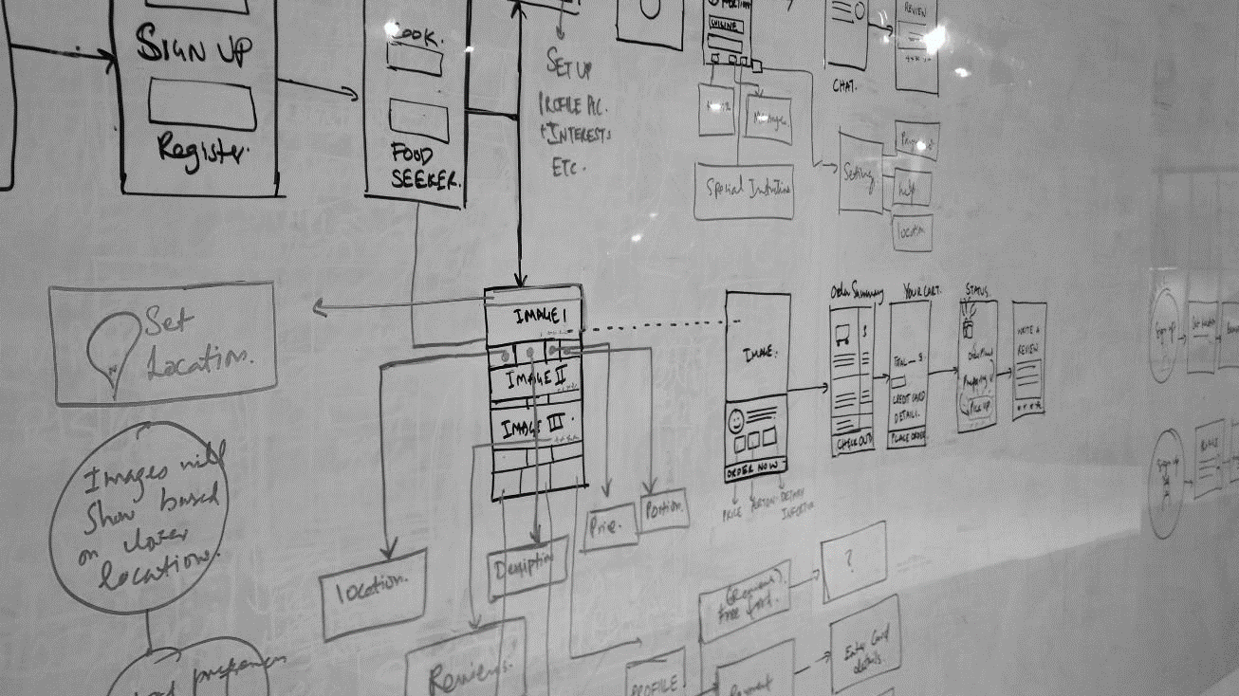
All elements in an experience are exchanges between people, brands, businesses, services, & increasingly, machine-powered intelligence.

Slide 62
Lab 3 & 3.1 – Build Forms & Add Language Understanding Intelligence

Slide 63
Call to action
Build bots—https://dev.botframework.com/
Docs—https://docs.microsoft.com/en-us/bot-framework/
GitHub—https://github.com/Microsoft/BotBuilder
Continue your education at Microsoft Virtual Academy online
#MSBuild

Slide 64
Q&A

Slide 65
Thank you!

Slide 66
Microsoft AI
Amplifying human ingenuity with intelligent technology

Slide 67
Microsoft AI
Data
Intelligence
Experiences
AI PLATFORM
INTELLIGENT AGENT
AI SOLUTIONS
APPLICATIONS

Slide 68
Microsoft AI Platform
Cloud-powered AI for everyday developer
Services
CUSTOM AI
PRE-BUILT AI
CONVERSATIONAL AI
CODING & MANAGEMENT TOOLS
Azure Machine Learning
Cognitive Services
Azure Bot Service
Tools
VS Tools for AI
Azure ML Studio
Azure ML Workbench
Others (PyCharm, Jupyter Notebooks…)
Infrastructure
DEEP LEARNING FRAMEWORKS
AI ON DATA
AI COMPUTE
3rd Party
Cosmos DB
SQL
DB
SQL
DW
Data Lake
Spark
DSVM
Batch AI
ACS
Edge
Cognitive Toolkit
TensorFlow
Caffe
CPU, FPGA, GPU
Others (Scikit-learn, MXNet, Keras, Chainer, Gluon…)
Notes:
The Microsoft AI Platform is cloud powered AI for every developer.
Working from the developer backwards, a the very top, we have the high level services for AI.
And Azure Machine Learning allows you to do data science and build sophisticated AI applications from the ground up.
Cognitive Services allows developers to infuse pre-built AI into every app.
The Bot Framework allows you to easily build chatbots.
This is all built on the infrastructure of the hyperscale cloud.
Here you have the power of the most advanced database services such as Cosmos DB, SQL DB, and Data Lakes to organize your data.
You have the power of distributed computing with Spark and Azure Batch and even IOT Edge.
All of this is built on the latest hardware – CPUs, GPUs and FPGAs.
And we provide great tools to assist the developer, as you will see in a moment.
Our platforms are open. They support all the popular open source frameworks for Machine Learning. And it’s easily extensible.
It’s a very rich, open, cloud based platform for highly productive application development.

Slide 69
Microsoft AI Platform
Enterprise-proven
Applications | Templates | Solutions
Services
Tools
Infrastructure
Notes:
The Microsoft AI Platform is cloud powered AI for every developer.
Working from the developer backwards, a the very top, we have the high level services for AI.
And Azure Machine Learning allows you to do data science and build sophisticated AI applications from the ground up.
Cognitive Services allows developers to infuse pre-built AI into every app.
The Bot Framework allows you to easily build chatbots.
This is all built on the infrastructure of the hyperscale cloud.
Here you have the power of the most advanced database services such as Cosmos DB, SQL DB, and Data Lakes to organize your data.
You have the power of distributed computing with Spark and Azure Batch and even IOT Edge.
All of this is built on the latest hardware – CPUs, GPUs and FPGAs.
And we provide great tools to assist the developer, as you will see in a moment.
Our platforms are open. They support all the popular open source frameworks for Machine Learning. And it’s easily extensible.
It’s a very rich, open, cloud based platform for highly productive application development.

Slide 70
AI resources Get started
Cognitive Services azure.com/cognitive
Azure Bot Service azure.com/bots
Machine Learning & Deep Learning aka.ms/mldeeplearning
OPPORTUNITIES
Get Started Guides aka.ms/csdoc
Azure Bot Service Quickstarts aka.ms/botquickstart
AI School aischool.microsoft.com/
AI Show channel9.msdn.com/Shows/AI-Show
Notes:
Confluence of cloud, data and AI is at the core of enabling the Microsoft mission of empowering people and organizations to achieve more
New insights from data, driven by advances in AI and powered by cloud, are the catalysts to augment the human ingenuity, removing friction and driving innovation
We want to empower today’s innovators to use data to reimagine products and experiences that will improve our world

Slide 71



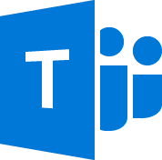

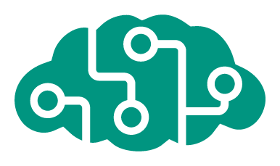







Azure Bot Service
Accelerate development
Enrich your bots
Operational efficiencies
</>
Powered by Azure Functions
Continuous deployment
Develop your way
Built in code editor
Channel support
Cognitive Services
API
Quick start templates
Integrated chat window
Direct Line support
Embedded web chat
Scale on demand
Reduced dev ops
Notes:
Bot Service provides what you need to build, connect, test, deploy, monitor, and manage bots. Bot Service provides the core components for creating bots, including the Bot Builder SDK for developing bots and the Bot Framework for connecting bots to channels.
Bot Service provides an integrated environment purpose-built for bot development. You can write a bot, connect, test, deploy, and manage it from your web browser with no separate editor or source control required. For simple bots, you may not need to write code at all. It is powered by the Bot Framework and it provides two hosting plans:1
With the App Service plan, a bot is a standard Azure web app you can set to allocate a predefined capacity with predictable costs and scaling.
With a Consumption plan, a bot is a serverless bot that runs on Azure Functions and uses the pay-per-run Azure Functions pricing.
Bot Service accelerates bot development with Five bot templates you can choose from when you create a bot. You can further modify your bot directly in the browser using the Azure editor or in an Integrated Development Environment (IDE), such as Visual Studio and Visual Studio Code.

Slide 72

AI for your business
$1.2T
estimated additional revenue/shifting revenue driven by AI in three years
Reasoning
Understanding
Interacting
Leverage your unique data and augment your business in new, unimaginable ways
Interpret business and customer data in real time and scale including text, docs, images, video, voice
Remove technology barriers with customers and multiply employee capabilities
Source: IDC

Slide 73
Why it matters
55%
40%
38%
US online adults will abandon online purchases if there is no quick answer to their questions¹
Boost in labor productivity in developed nations by 2035 through AI potential²
Boost in rates of profitability in developed nations by 2035 through AI potential³
Source: 1 Forrester; 2, 3 Accenture
Notes:
Accenture – Why artificial intelligence is the future of growth - This rise in labor productivity will not be driven by longer hours but by innovative technologies enabling people to make more efficient use of their time.
Indeed, Servion predicts that, by 2025, AI will power 95% of all customer interactions, including live telephone and online conversations that will leave customers unable to ‘spot the bot’. http://servion.com/blog/ai-will-power-95-customer-interactions-2025/

Slide 74
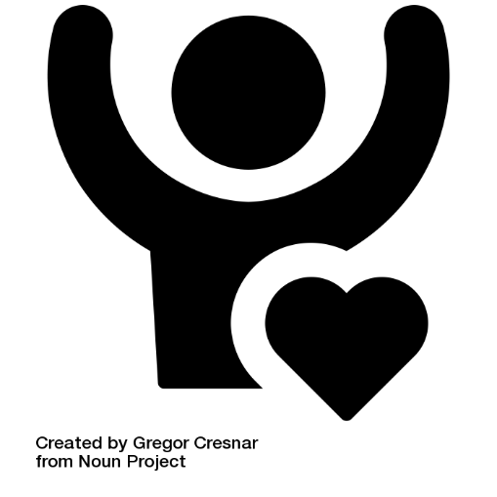
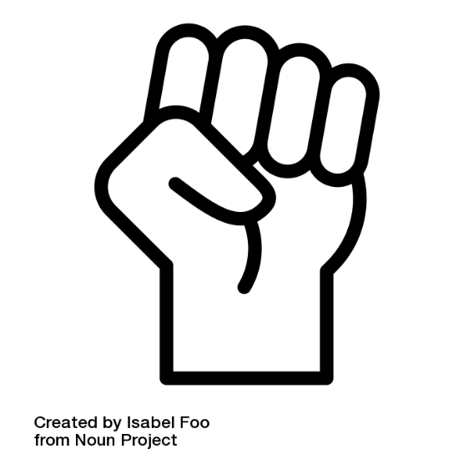

What it means for your business
Engage customers
Build a loyal customer base with a 24/7 customer-centric approach to your business
Empower employees
Increase employee productivity and allow for focus on innovation by freeing up time through automation
Reimagine business
Automate business processes, increase revenue through targeted outreach, and enhance your products with insights

Slide 75
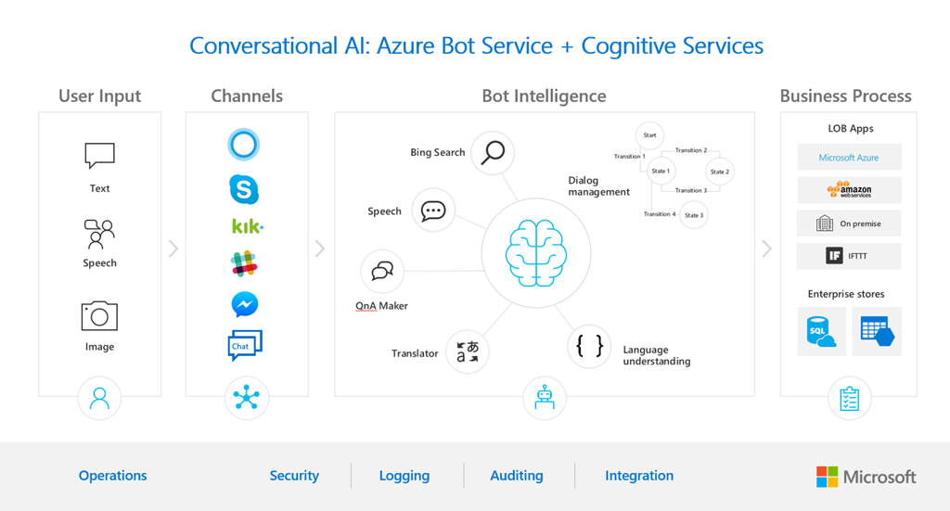

Slide 76


What is the bot framework?
Build and connect intelligent bots
The bot framework provides tools and resources for designing, building, deploying, and managing bots
Network of Microsoft customers
Bots connect to Microsoft properties, such as Cortana, LinkedIn, Skype, and Office 365

Slide 77



New docs!
#1 Requested Feature
Comprehensive
Bot design
Searchable
Scenario-based
Patterns and practices
Integrated with APIs
Well organized and discoverable
Samples
Easy to read

Slide 78
Highlights
Improvements Everywhere!
Bot builder
Platform
Intelligence
SDK updates
Speech support
Improved dialog tools
Debugging improvements
Channel inspector
Improved tooling
New channels
Cortana
Bing
Skype for Business
Adaptive cards
Speech support
Payments
Analytics
Bot controls
Speech support
Cognitive services

Slide 79


Bot discovery
Bing Search for Bots
Bing Search Terms
Top bots
Top Skype bots
Famous Skype bots
Best Facebook bots
Latest Slack bots

Slide 80

Bot analytics

Slide 81


New channels
One Bot
Multiple canvases
Custom skills
Business bots
LOB bots
Memory/profile
Top bots
IT managed
Speech
Bots in Bing search
Integrated auth

Slide 82

New channels
One BOT
Multiple canvases
One Bot
Multiple canvases

Slide 83
Inclusive design
A design methodology that enables and draws on the full range of human diversity.

Slide 84
3 principles of inclusive design
Recognize exclusion
Exclusion happens when we solve problems using our own biases
Learn from Diversity Human beings are the real experts in adapting to diversity
Solve for one, extend to many
by focusing on what's universally important to all humans

Slide 85
Beyond the Architecture
Solving real business problems is key
Good bot design and user experience are critical to success
Bot personality brings your brand to life and is the voice of your company to the consumer
User experience—usability drives adoption
Bots should do more than answer questions—they should also complete tasks on the users behalf
Telemetry = Business Insights

Slide 86

What makes a Bot great?
It is not how much AI it has
It is not how much natural language it offers
It is not whether it uses voice or not
Notes:
Most successful apps or websites have at least one thing in common: a great user experience. Bots are no different in that regard. Therefore, ensuring a great user experience should be your number one priority when designing a bot. Some key considerations include:
Does the bot easily solve the user’s problem with the minimum number of steps?
Does the bot solve the user’s problem better/easier/faster than any of the alternative experiences?
Does the bot run on the devices and platforms the user cares about?
Is the bot discoverable? Do the users naturally know what to do when using it?
Note that none of these questions directly relates to factors such as how smart the bot is, how much natural language capability it has, whether it uses machine learning, or which programming language was used to create it. Users are unlikely to care about any of these things if the bot solves the problem that they need to address and delivers a great user experience. A great bot user experience does not require users to type too much, talk too much, repeat themselves several times, or explain things that the bot should automatically know.

Slide 87
Factors that do influence a bot’s success
Does the bot easily solve the user’s problem with the minimum number of steps?
Does the bot solve the user’s problem better/easier/faster than any of the alternative experiences?
Does the bot run on the devices and platforms the user cares about?
Is the bot discoverable? Do the users naturally know what to do when using it?
Notes:
Most successful apps or websites have at least one thing in common: a great user experience. Bots are no different in that regard. Therefore, ensuring a great user experience should be your number one priority when designing a bot. Some key considerations include:
Does the bot easily solve the user’s problem with the minimum number of steps?
Does the bot solve the user’s problem better/easier/faster than any of the alternative experiences?
Does the bot run on the devices and platforms the user cares about?
Is the bot discoverable? Do the users naturally know what to do when using it?
Note that none of these questions directly relates to factors such as how smart the bot is, how much natural language capability it has, whether it uses machine learning, or which programming language was used to create it. Users are unlikely to care about any of these things if the bot solves the problem that they need to address and delivers a great user experience. A great bot user experience does not require users to type too much, talk too much, repeat themselves several times, or explain things that the bot should automatically know.

Slide 88
Great bots are like great apps; they appeal to users because…
…they do whatever they're trying to do WELL

